Slide 1

JULIUS M.
FREELANCE DATA SCIENTIST
Metagenomic
Classification
An Emerging Healthcare Trend

Slide 2

Build a ML model to predict the body site origin of microbiome samples (gut, oral, skin, nasal) using 16S rRNA metagenomic data encoded in MPEG-G format, advancing microbiome-based health insights and bioinformatics compression standards.
The Mission

Slide 3
Decompression & Extracting Features
- About 20gb of compressed data in MPEG format is provided
-Used Genie Docker Image to decompress the files to .fastq format.
- Ended up with over 200gb of data!
-This process took roughly an hour on my local desktop
Our Data
Handling

Slide 4





Feature Extraction
Extracted 94 features from FASTQ files—covering read statistics, GC content, sequence complexity, quality scores, and k-mer frequencies—to capture both biological composition and sequencing quality for robust microbiome classification modeling.
-This took about 4hrs for train, 2hrs for test set

Slide 5

Feature
Engineering
Adding onto the initial features
-Derived biologically and statistically meaningful features from initial sequence summaries—capturing nucleotide composition, k-mer diversity, codon patterns, and nonlinear interactions—to model sequence variability and improve classification accuracy
-Total of 117 features used at the end for modelling

Slide 6

Centralized Modelling
Tuning
Used Optuna with Stratified 10-Fold Cross-Validation to minimize log loss and optimize key XGBoost parameters (learning_rate, max_depth, subsample, colsample_bytree, min_child_weight).
This systematic search improved model generalization and stability across folds.
Training
Trained XGBoost using 10-fold Stratified Cross-Validation with previously tuned hyperparameters.
Used out-of-fold (OOF) predictions to estimate unbiased performance and compute overall CV log loss.
Tracked energy consumption using EmissionsTracker for sustainable model development.
-The Average CV was around 0.03

Slide 7
Inference on Test
All Folds
Used all trained XGBoost folds to generate test predictions.
Ensembling
Each model produced class probabilities, which were ensembled via geometric mean for robustness.
Generating Submission
Final class labels were obtained from the highest averaged probability and exported as a structured CSV with per-sample probabilities.
-CV 0.038, Public Leaderboard 0.0037 & Private Leaderboard 0.018

Slide 8
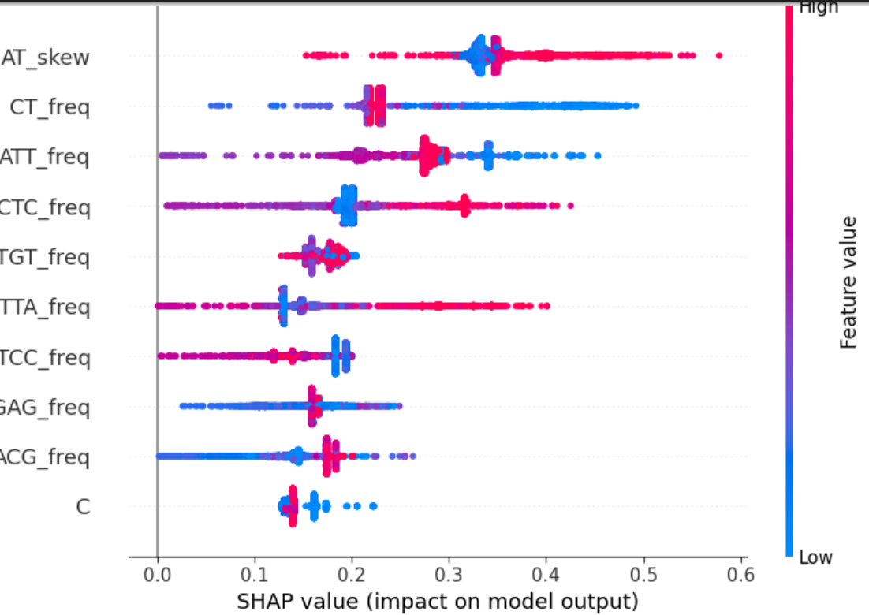
Discussion of Results
SHAP analysis revealed distinct k-mer and compositional patterns driving predictions for each body site.
k-mer frequencies
Different k-mer frequencies (e.g., TCT, ATT, CTC) dominate per class, showing biologically meaningful sequence motifs.
Global features
Global features like AT_skew and CT_freq consistently influenced predictions across samples.

Slide 9
Cyclic Federated Learning
Federated Learning is a collaborative machine learning approach where multiple clients (devices or institutions) train a shared model without exchanging raw data.
Traditional Federated Learning (FedAvg)
Cyclic Federated Learning (CFL)
Clients train locally and send updates to a central server, which averages them into a global model.
✅ Scalable, parallel training, and widely used in practice.
⚠️ Requires a server and can struggle with very different (non-IID) data.
The global model is passed client-to-client in a cycle, each site updating before handing it on.
✅ No server required, simpler communication, fits decentralized settings.
⚠️ Sequential (slower) and client order can influence results.
McMahan et al., 2017 — [FedAvg Paper]
Pengyu et al., 2021 — [Cyclic FL]

Slide 10

🧬 Client Data & 🔄 Cyclic Federated Training
-Previous model (XGBoost) used in training centralised model is implimented using exactly same 117 features.
-Client Setup:
Each client corresponds to a distinct metabolic phenotype — Control, Crossover, Diabetic, and Prediabetic — derived from the composite glucose–insulin “Class” label.
Labels normalized and data split per class → one dataset per site.
Ensures biologically meaningful and site-specific federated clients.
-Federated Training:
Uses a cyclic XGBoost scheme, where the global model is trained sequentially across clients each round.
Each site performs local boosting, updates the shared global model, and passes it to the next site.
After each global cycle → evaluate on pooled validation data (log loss, accuracy).
-Final trained model saved as global_bst.json
.
-Use the model for inference on test
-Results: CV:0.0281,Public.L 0.0018, Private.L 0.015

Slide 11
Thank You
Julius M.

